Slide 1
EXECUTIVE PRESENTATION
OmniTenant: Autonomous AI Commerce Platform
Eliminating manual order work and stockouts for modern B2B and B2C brands

Slide 2

TABLE OF CONTENTS
Six Steps to Autonomous Commerce
01 The Problem: Manual B2B orders, flash-sale overselling, and tied-up capital
02 The Solution: One unified platform powered by AI and real-time stock control
03 Key Capabilities: Closed-loop AI agents and instant multichannel inventory sync
04 Business Impact: 300x faster order entry, zero overselling, and lower costs
05 UI/UX Prototype: Role-based interfaces across Owner, Warehouse, and Storefront
06 Conclusion: Strategic takeaway and future vision for autonomous brands

Slide 3
01. THE INDUSTRY PROBLEM
Three Operational Bottlenecks Drain Brand Revenue
Slow B2B Ordering
15-20 Mins: Manual entry from chats and paper invoices
12% Error Rate: Frequent SKU mistakes delay shipments
Flash Overselling
10,000 Req/s: Traffic spikes overwhelm standard stores
Lost Trust: Cancelled orders hurt brand reputation
Blind Inventory
>30 Days Idle: Slow-moving stock locks up cash flow
Sudden Stockouts: Bestsellers run out without early alerts

Slide 4

02. OUR SOLUTION
Unifying AI and Real-Time Stock
Unified Commerce Hub: Connects B2B wholesale and multichannel B2C sales in one place
Autonomous AI Brain: Automates order capture, stock forecasting, and smart clearance
Zero-Overselling Core: Locks inventory instantly during high-traffic flash sales
Multi-Brand Privacy: Keeps every business's commercial data strictly isolated

Slide 5
03. KEY CAPABILITIES — AI AUTOMATION
Three AI Agents Automate Daily Supply Chain Work
Snap-to-Order AI
3-Sec Entry: Turns invoice photos into B2B orders
High Accuracy: Matches item names with >=80% confidence
Smart Restocking
30-Day Velocity: Tracks sales speed to predict stockouts
Auto Draft POs: Prepares purchase orders before stock runs out
Dynamic Markdowns
Slow-Stock Scan: Flags items unsold for over 30 days
Profit Guard: Clears stock with a >=10% margin floor

Slide 6

03. KEY CAPABILITIES — RELIABLE OPERATIONS
Real-Time Sync Prevents Overselling
Instant Checkout Lock: Reserves stock in 10ms so two buyers never claim one item
Auto Stock Recovery: Releases unpaid cart reservations after 15 minutes
Multichannel Sync: Unifies inventory across Shopify, Shopee, Lazada, and TikTok
Zero Double Charges: Blocks duplicate payments caused by slow network clicks

Slide 7
04. BUSINESS IMPACT
Autonomous Operations Deliver 300x Faster Order Processing
3 Sec vs. 15 Min: 300x faster B2B wholesale order entry with AI
0% Overselling: 100% inventory accuracy during peak flash sales
2.4x Capital Turn: Faster inventory turnover through smart clearance
80% Lower Cost: Shared multi-tenant platform cuts infrastructure spend

Slide 8
04. COMPETITIVE ADVANTAGE
OmniTenant Outperforms Legacy ERPs and Standard Stores
Capability | Legacy ERP / WMS | Standard E-Commerce | OmniTenant Platform
B2B Order Entry | Manual typing (15m) | Paid 3rd-party apps | AI Snap-to-Order (3s)
Stock Forecasting | Static min/max rules | Passive stock alerts | Predictive AI & Auto-PO
Slow-Stock Clearance | Monthly spreadsheets | Manual promo codes | 1-Click Margin-Safe Promo
Flash-Sale Traffic | Slow under web spikes | Prone to overselling | Zero-Overselling Lock
Multi-Brand Cost | High per-user license | Per-store monthly fee | 80% Lower Shared Cost

Slide 9
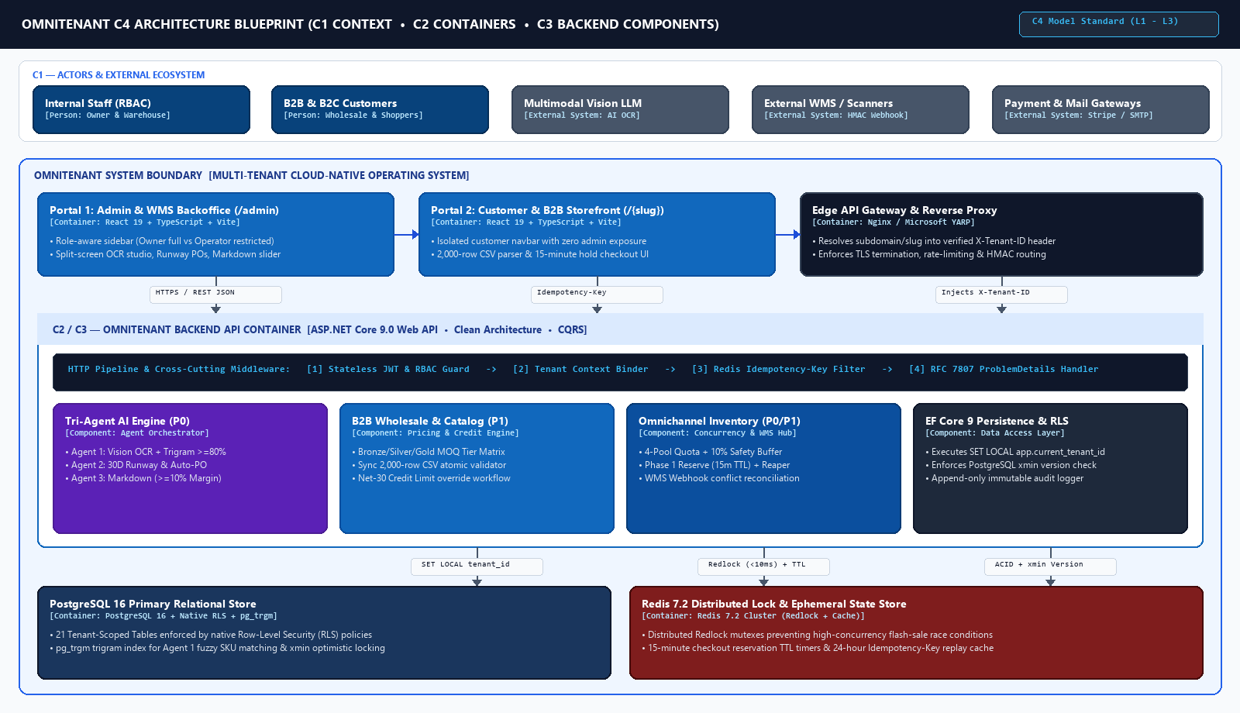
05. C4 SYSTEM ARCHITECTURE
C1 Context, C2 Containers & C3 Components
• 01 C1 System Context: Connects 4 user roles with Vision LLM, WMS Webhooks, and Payment Gateways
• 02 C2 Web & Edge Proxy: Two isolated React 19 apps (/admin & /{slug}) routed via YARP Reverse Proxy
• 03 C3 .NET 9 Backend: Clean Architecture API running the Tri-Agent AI Engine, B2B Pricing, and WMS Hub
• 04 C2 Data & Locking: PostgreSQL 16 (21 RLS tables + xmin) paired with Redis 7.2 (Redlock + 15m holds)
SCREEN FILE: docs/images/c4-architecture.png — Full-Stack C4 Architecture Blueprint (L1 - L3)

Slide 10
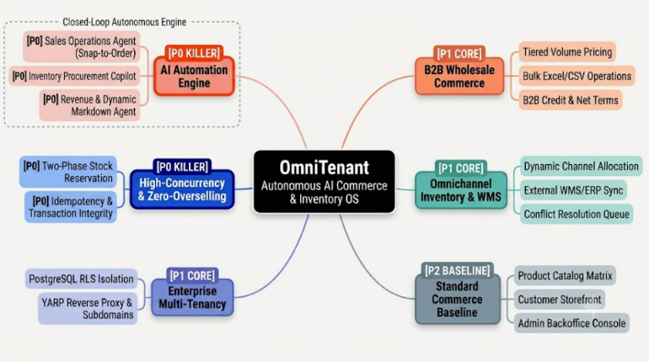
05. UI/UX & ARCHITECTURE — MINDMAP
Core Modules & Feature Priority
• 01 Purpose: Maps out all 6 modules of the OmniTenant platform by priority
• 02 P0 AI Engine: Agent 1 (Snap-to-Order), Agent 2 (Runway Copilot), and Agent 3 (Markdown)
• 03 P0 Stock Locking: Two-Phase reservation preventing flash-sale overselling
• 04 P1 & P2 Foundation: B2B wholesale tiers, WMS sync, and PostgreSQL RLS tenant isolation
SCREEN FILE: docs/images/mindmap.png — System Capability Mindmap

Slide 11
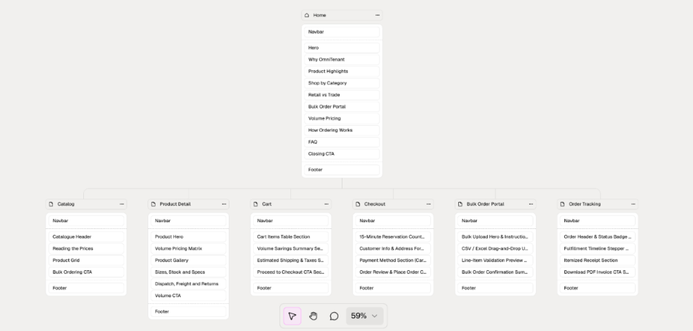
05. UI/UX & ARCHITECTURE — SITEMAP
Customer & B2B Storefront Page Flow
• 01 Target Users: B2B Wholesale Buyers and B2C Online Shoppers
• 02 Browse & Product: View catalog items, live stock counts, and B2B volume discounts
• 03 Cart vs Checkout: Add items freely in Cart; 15-minute stock lock starts only at Checkout
• 04 Bulk & Tracking: Upload 2,000-row CSV wholesale orders and track real-time shipments
SCREEN FILE: docs/images/sitemap.png — Storefront Navigation Hierarchy

Slide 12
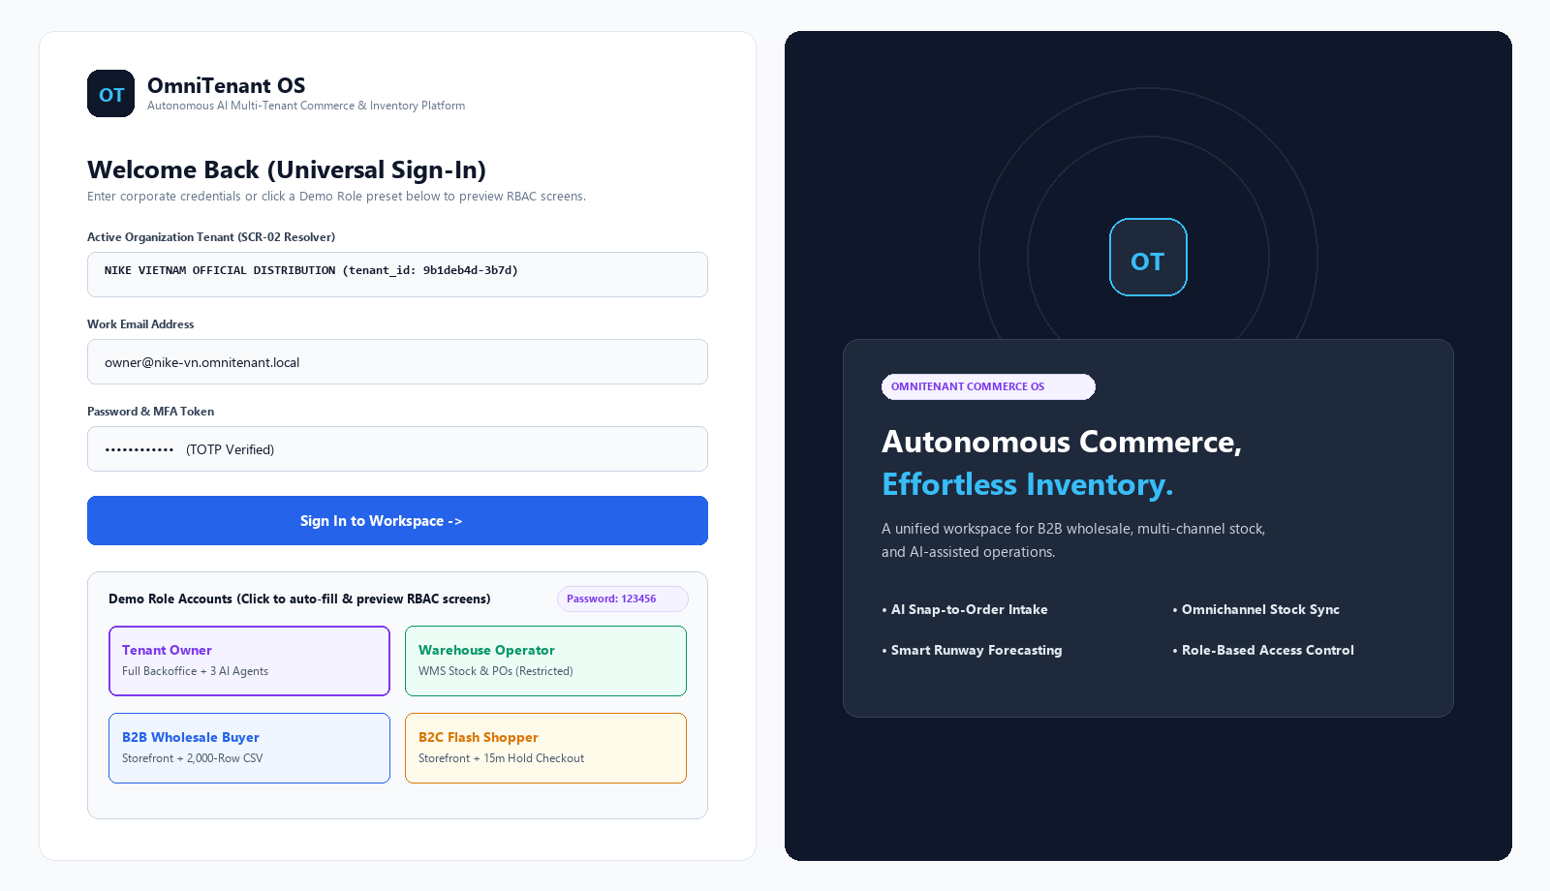
05. UI/UX PROTOTYPE — UNIVERSAL SIGN-IN
Multi-Tenant Login & Role Switcher
• 01 Target Users: All 4 user roles (Owner, Warehouse Staff, B2B Buyer, B2C Shopper)
• 02 Purpose: Authenticate into the active tenant workspace (NIKE VIETNAM)
• 03 Where to Click: Click any of the 4 Demo Role cards at the bottom-left to auto-fill credentials
• 04 Final Action: Click [Sign In to Workspace ->] to open that role's dedicated portal
SCREEN FILE: docs/images/chung/01-login-role-switcher.png — Login & RBAC Switcher

Slide 13
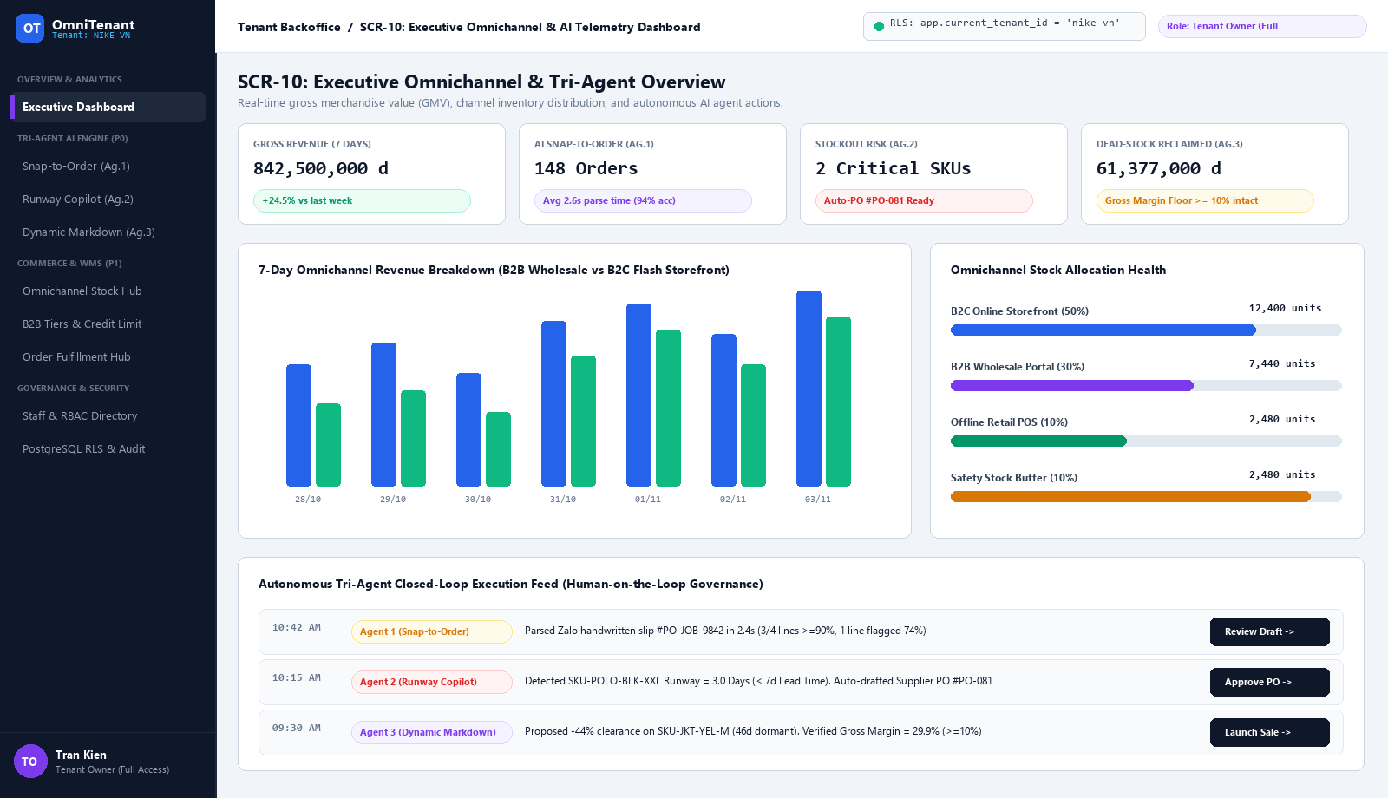
05. UI/UX PROTOTYPE — TENANT OWNER
Executive Dashboard & AI Action Feed
• 01 Target User: Tenant Owner (Full access to all 8 sidebar menus)
• 02 Purpose: Monitor 7-day B2B vs B2C revenue, channel stock, and pending AI tasks
• 03 Where to Look: Check the top KPI cards, revenue chart, and 4 channel stock bars
• 04 Where to Click: Click [Review Draft], [Approve PO], or [Launch Sale] in the bottom AI feed
SCREEN FILE: docs/images/tenant-owner/01-dashboard.png — Executive Overview (SCR-10)

Slide 14
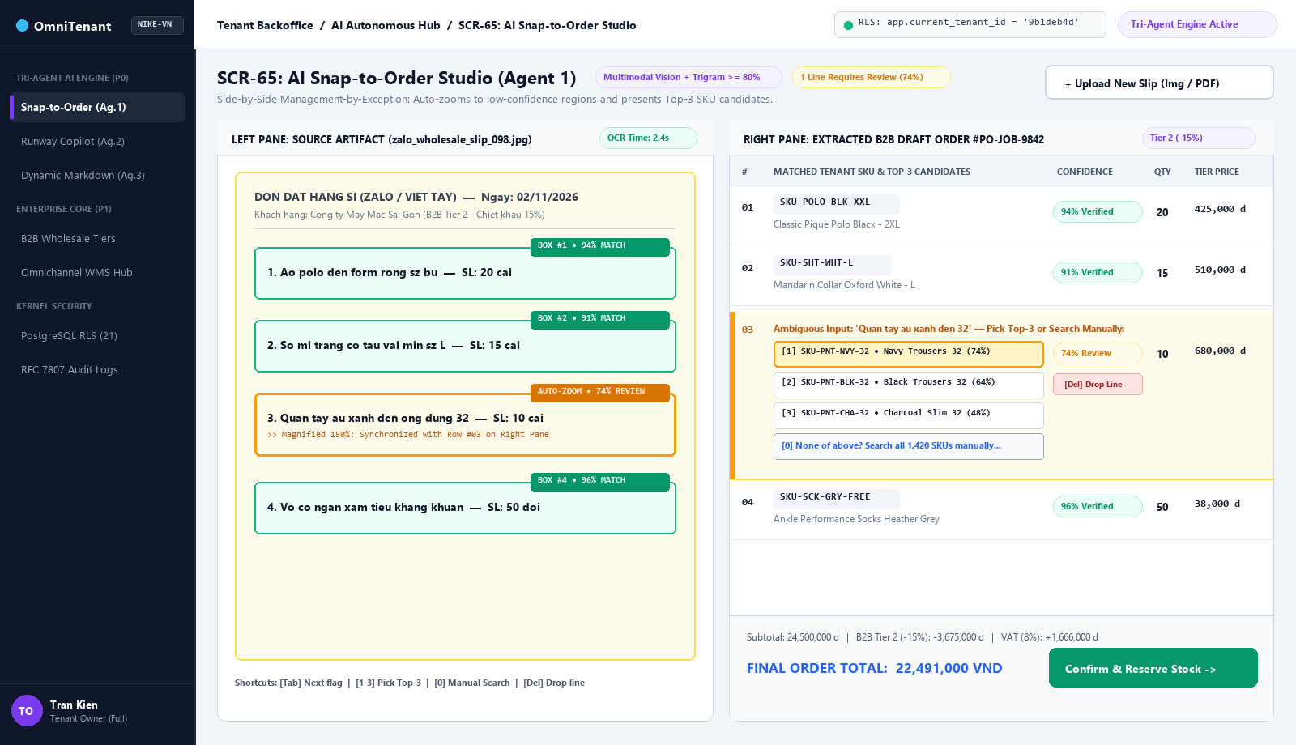
05. UI/UX PROTOTYPE — TENANT OWNER
Agent 1: AI Snap-to-Order Studio
• 01 Target Users: Tenant Owner & Sales Operator
• 02 Purpose: Turn handwritten Zalo order photos into B2B orders in 3 seconds
• 03 Where to Click: Click yellow Row #03 (74% match) to pick Top-3 SKU, or press [0] to search
• 04 Final Action: Click [Confirm & Reserve Stock ->] at the bottom-right to lock stock
SCREEN FILE: docs/images/tenant-owner/02-ai-snap-to-order.png — Snap-to-Order Studio (SCR-65)

Slide 15
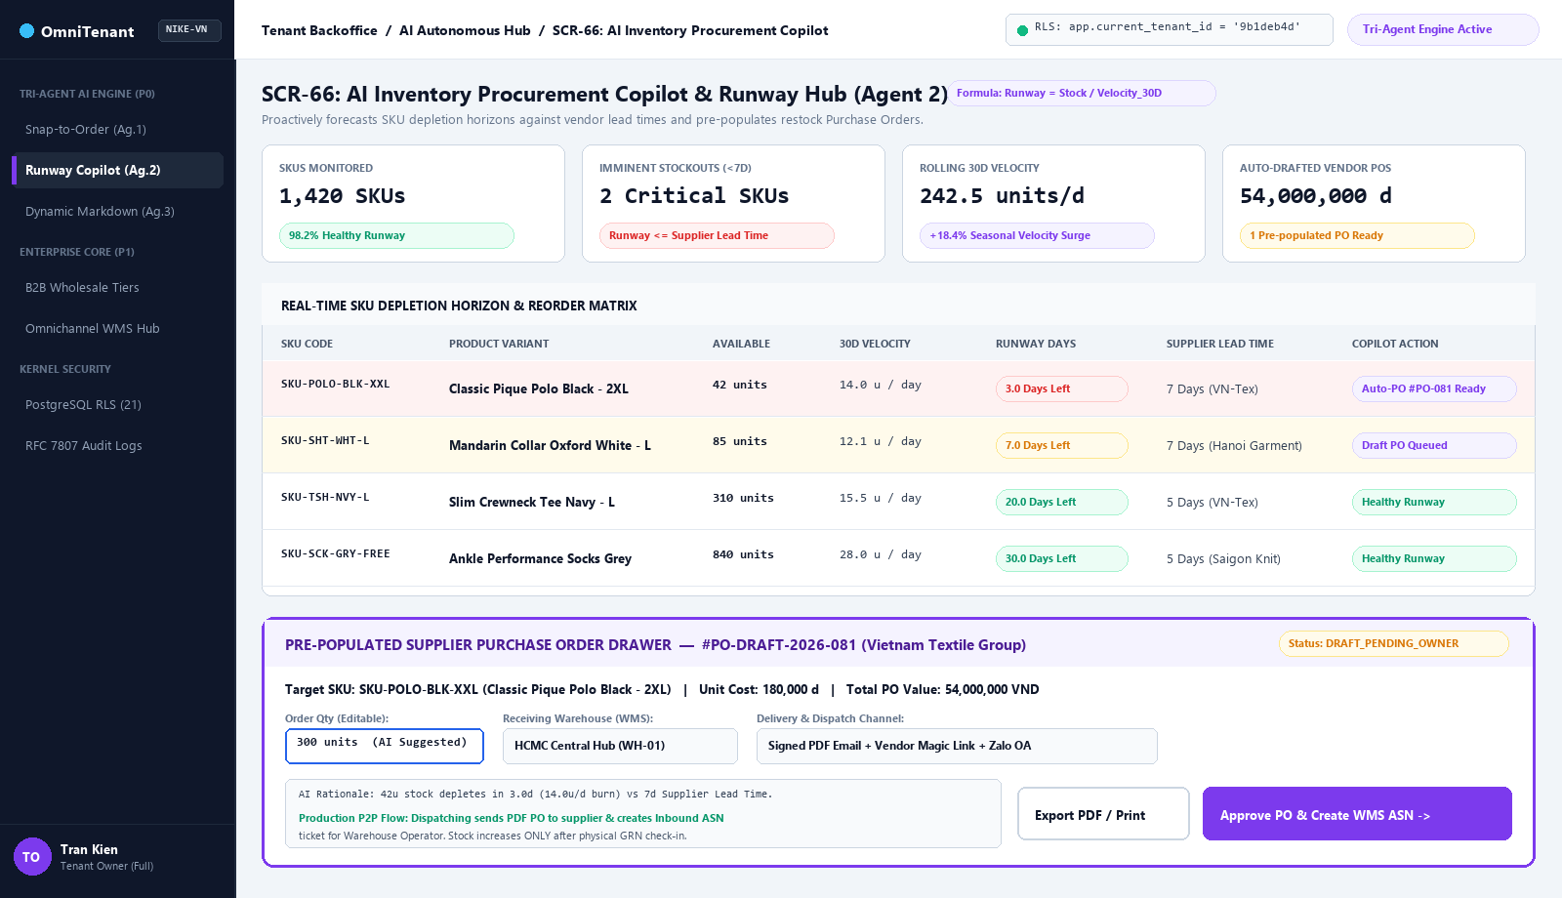
05. UI/UX PROTOTYPE — TENANT OWNER
Agent 2: AI Inventory Procurement Copilot
• 01 Target Users: Tenant Owner & Warehouse Manager
• 02 Purpose: Spot SKUs running out of stock (< 7 days) and send restock POs to suppliers
• 03 Where to Edit: Adjust [Order Qty (300u)] and [Receiving Warehouse] in the bottom drawer
• 04 Final Action: Click [Approve PO & Create WMS ASN ->] to email the supplier and notify WMS
SCREEN FILE: docs/images/tenant-owner/03-ai-procurement-copilot.png — Procurement Copilot (SCR-66)

Slide 16
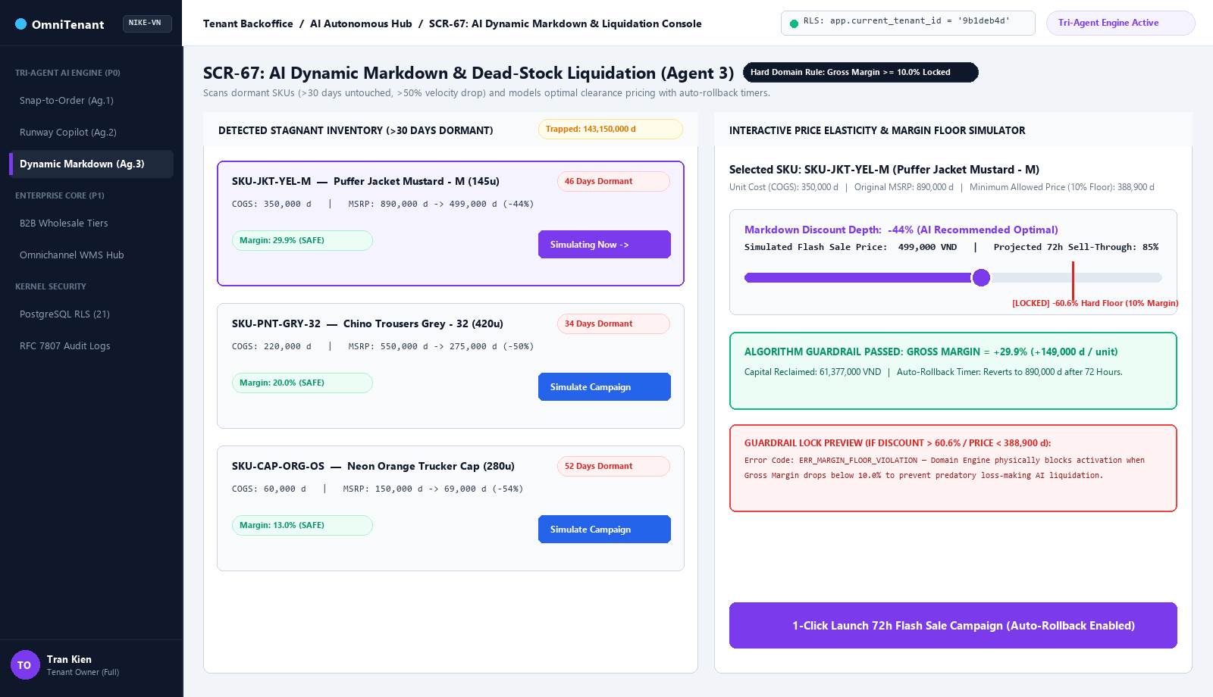
05. UI/UX PROTOTYPE — TENANT OWNER
Agent 3: AI Dead-Stock Markdown Console
• 01 Target User: Tenant Owner Only (Hidden from Warehouse Operators)
• 02 Purpose: Clear out slow-moving items (> 30 days) without losing profit margin
• 03 Where to Click: Select an item on the left, then drag the purple discount slider on the right
• 04 Final Action: Click [1-Click Launch 72h Flash Sale] (locked if margin drops below 10%)
SCREEN FILE: docs/images/tenant-owner/04-ai-dynamic-markdown.png — Dynamic Markdown Console (SCR-67)

Slide 17
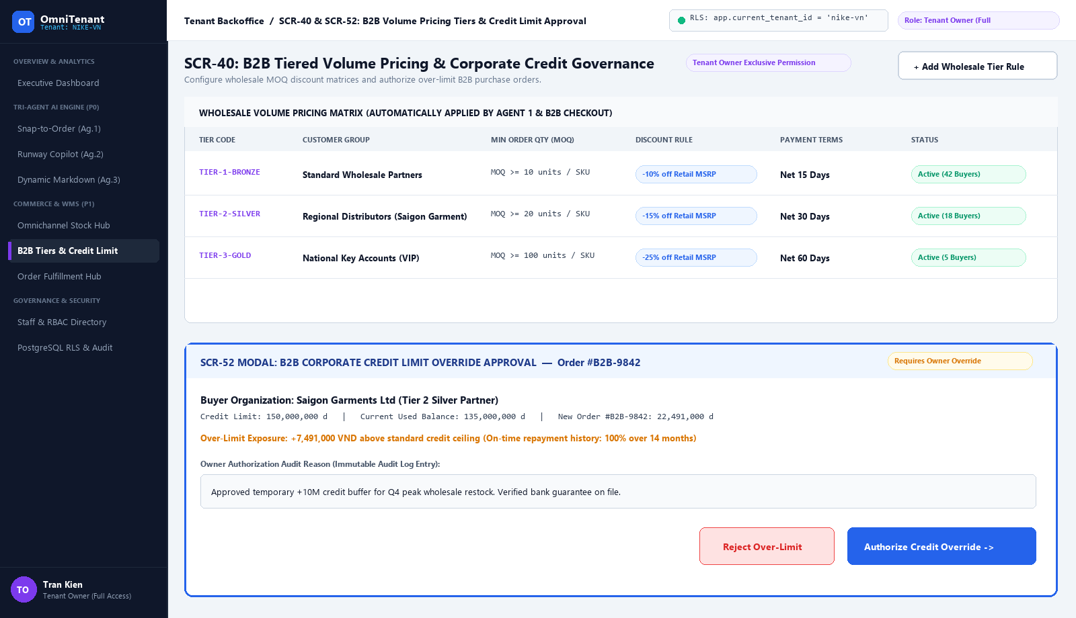
05. UI/UX PROTOTYPE — TENANT OWNER
B2B Wholesale Tiers & Credit Approval
• 01 Target User: Tenant Owner Only (Exclusive financial permission)
• 02 Purpose: Set B2B bulk discount rules and approve orders that exceed credit limits
• 03 Top Table: Click [+ Add Wholesale Tier Rule] to configure Bronze, Silver, and Gold MOQs
• 04 Bottom Modal: Enter an audit reason and click [Authorize Credit Override ->] to release order
SCREEN FILE: docs/images/tenant-owner/05-b2b-pricing-credit.png — B2B Pricing & Credit (SCR-40 & SCR-52)

Slide 18
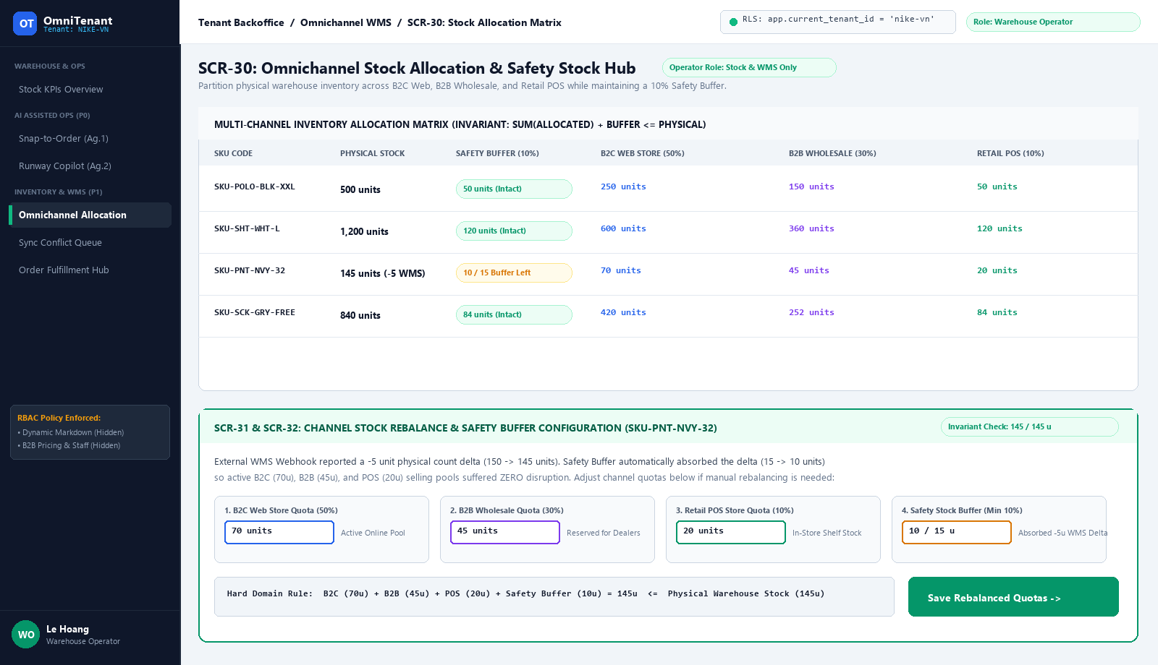
05. UI/UX PROTOTYPE — WAREHOUSE OPERATOR
Omnichannel Stock Allocation & Rebalance
• 01 Target User: Warehouse Operator (Pricing and credit menus are hidden by RBAC)
• 02 Purpose: Split physical stock across B2C (50%), B2B (30%), POS (10%), and Buffer (10%)
• 03 Where to Edit: Type new channel quotas into the 4 input boxes inside the bottom drawer
• 04 Final Action: Click [Save Rebalanced Quotas ->] to shift stock between sales channels
SCREEN FILE: docs/images/warehouse-operator/01-omnichannel-allocation.png — Stock Allocation Hub (SCR-30)

Slide 19
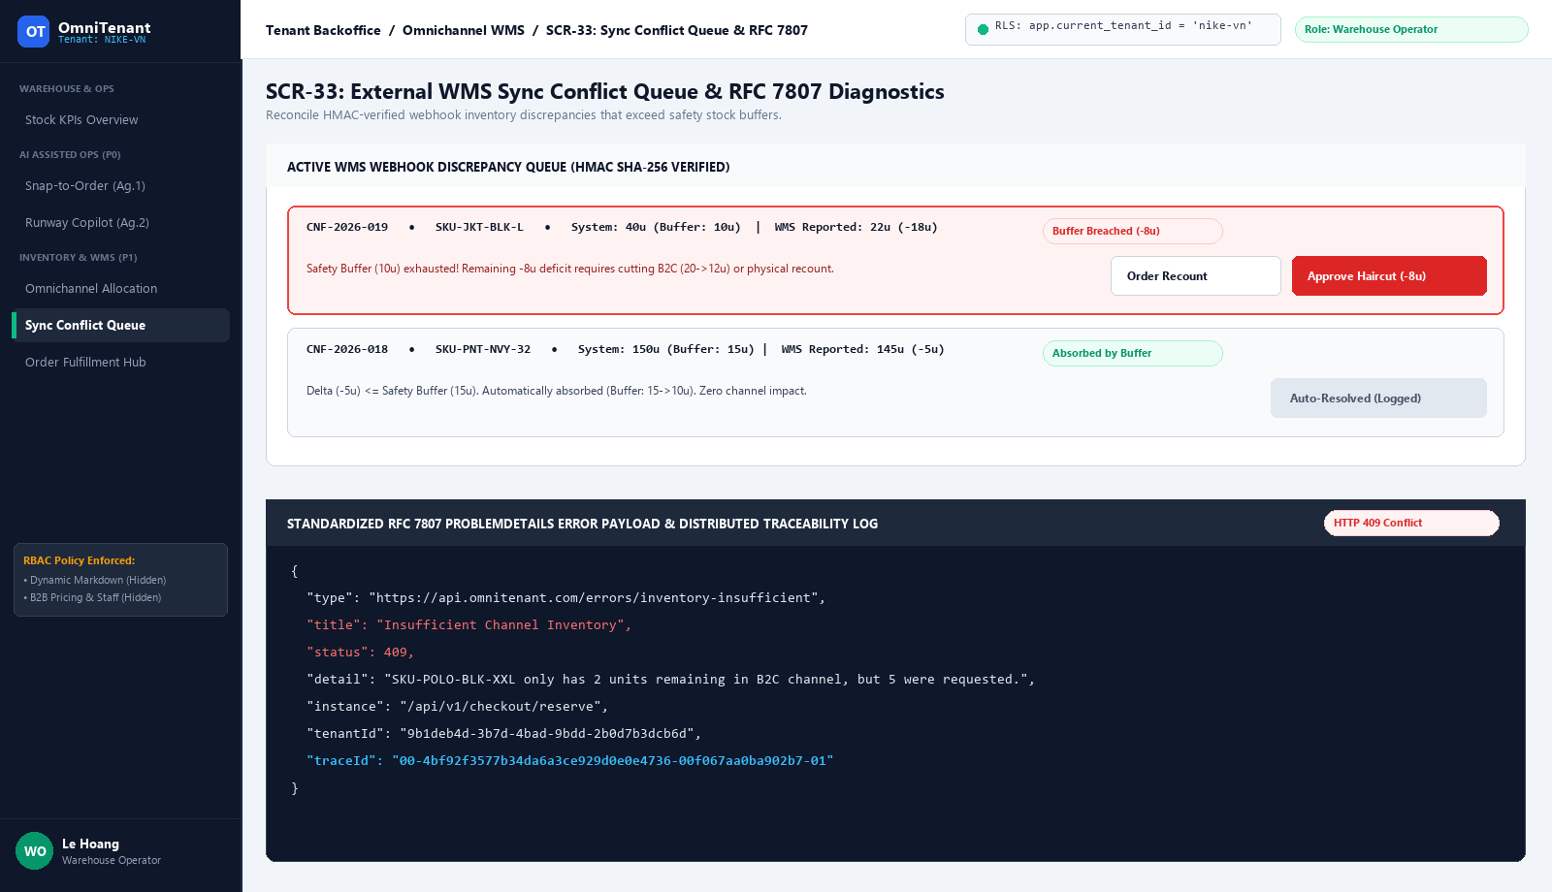
05. UI/UX PROTOTYPE — WAREHOUSE OPERATOR
WMS Sync Conflict Queue & Error Logs
• 01 Target User: Warehouse Operator
• 02 Purpose: Resolve physical stock shortages when warehouse counts drop below the buffer
• 03 Where to Click: On red alert CNF-2026-019 (-18u shortage), review the -8u buffer breach
• 04 Final Action: Click [Order Recount] to re-verify shelves or [Approve Haircut (-8u)] to cut B2C stock
SCREEN FILE: docs/images/warehouse-operator/02-sync-conflict-queue.png — Conflict Queue & RFC 7807 (SCR-33)

Slide 20
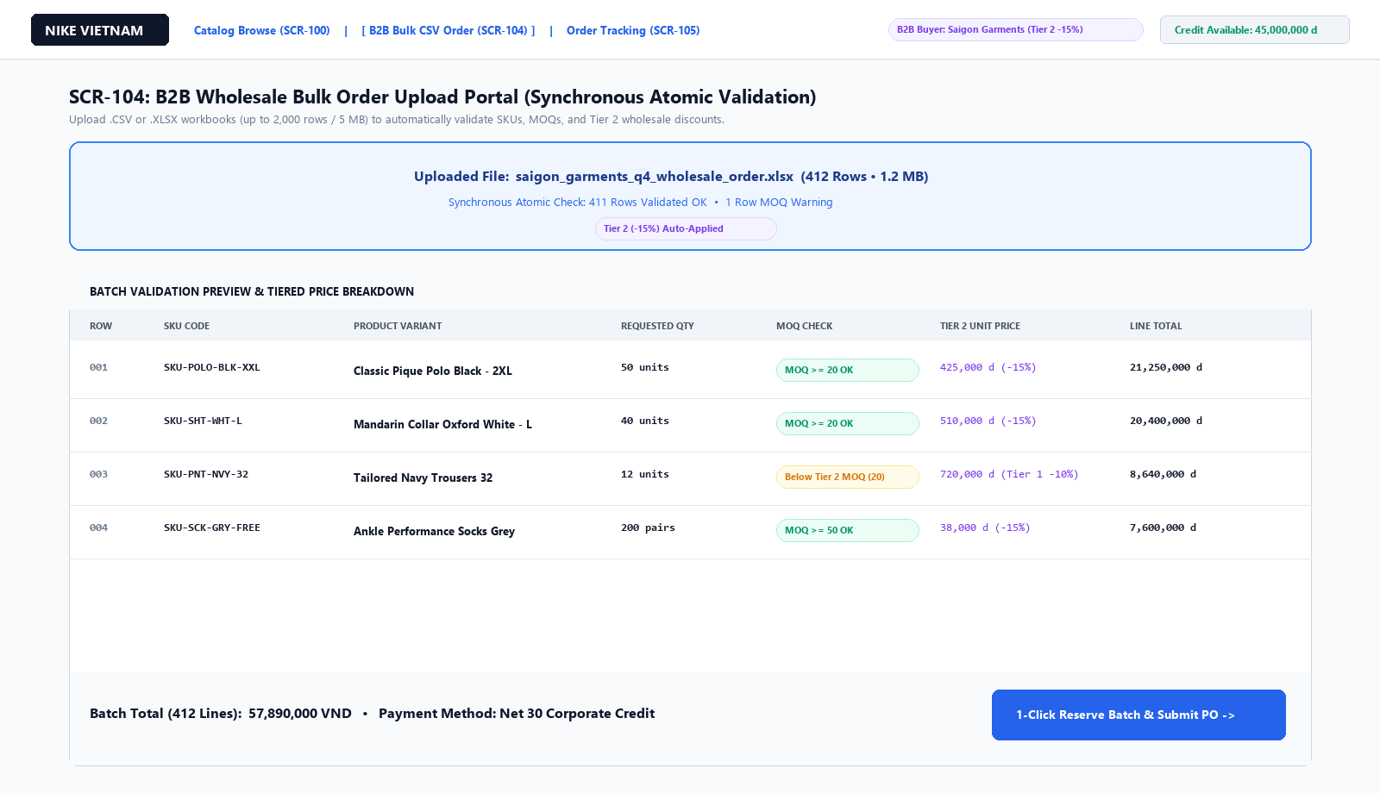
05. UI/UX PROTOTYPE — CUSTOMER STOREFRONT
B2B Wholesale Bulk CSV Upload Portal
• 01 Target User: B2B Wholesale Buyer / Dealer (Using the separate Customer Storefront)
• 02 Purpose: Place large wholesale orders (up to 2,000 rows) by uploading an Excel/CSV file
• 03 Where to Click: Drop the .XLSX file into the blue upload zone to check SKUs, MOQs, and Tier 2 prices
• 04 Final Action: Click [1-Click Reserve Batch & Submit PO ->] to lock all 412 lines at once
SCREEN FILE: docs/images/storefront/01-b2b-bulk-order-portal.png — B2B Bulk Order Portal (SCR-104)

Slide 21
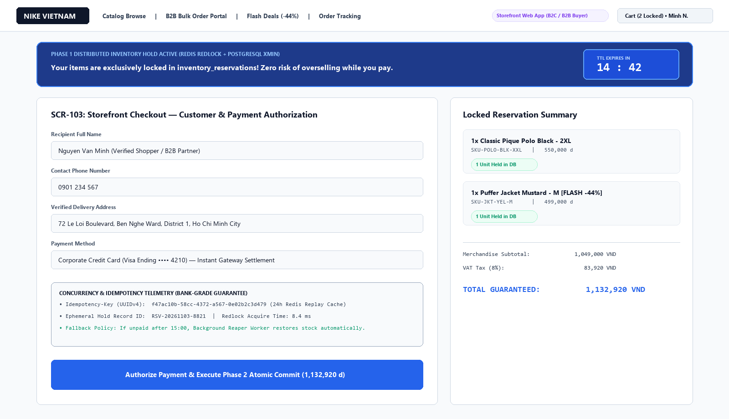
05. UI/UX PROTOTYPE — CUSTOMER STOREFRONT
High-Concurrency 15-Minute Hold Checkout
• 01 Target Users: B2C Flash-Sale Shopper & B2B Buyer paying by credit card
• 02 Purpose: Lock cart items for 15 minutes during checkout so nobody steals them while paying
• 03 Where to Fill: Enter delivery details and payment card while the 14:42 blue timer counts down
• 04 Final Action: Click [Authorize Payment & Execute Phase 2 Atomic Commit] to complete purchase
SCREEN FILE: docs/images/storefront/02-checkout-15m-hold.png — 15-Minute Hold Checkout (SCR-103)

Slide 22
06. CONCLUSION
Autonomous AI Is the Future of Multichannel Commerce.
• Bank-Grade Multi-Tenant Foundation:
21 PostgreSQL RLS policies, RFC 7807 observability, and Two-Phase Redis Redlock ensuring 0% cross-tenant leakage and zero overselling.
• Closed-Loop Tri-Agent Automation:
Unifying Order Intake (Agent 1), Stockout Prevention (Agent 2), and Dead-Stock Liquidation (Agent 3) into a single self-driving workflow.
• Measurable Business Impact:
90% faster B2B order processing, 2.4x faster capital turnover, and a strict >=10% Gross Margin guardrail.
Thank You For Listening

